Slide 1


Individual Honours Project
WEEKLY REPORT
Dang Khoa Cao - Supervisor: PhD. Chi Thanh Vi
UIT ID: 23560023 | BCU ID: 25195675
23560023@gm.uit.edu.vn | dang.cao@mail.bcu.ac.uk
UIT - BCU

Slide 2
TABLE OF CONTENTS
Date: 23 Apr 2026
Summary
Finished tasks
Current difficulties
Next plan

Slide 3

I. Summary
This is the report of my project “BCG: A Game-Based Approach to Motor Imagery Adaptation and BCI Calibration.”
The target was to make EEG-based motor imagery calibration more effective and easier to apply outside the laboratory.

Slide 4
I. Finished tasks
1. Model training ^{[STP7]} – 100%
STRATEGY 1
Classical ML on MIMED dataset
- Initial approach using CSP (Common Spatial Pattern) with classical classifiers. MIMED was chosen as the primary dataset because it was recorded on the EMOTIV Epoc X.
- However, the dataset suffers from very few trials per subject (~8), which causes unstable CSP covariance estimation and poor generalization.
Model | Classes | Protocol | Accuracy
CSP + LDA | 4-class | Cross-subject, 5-fold | 52.5%
CSP + SVM | 4-class | Cross-subject, 5-fold | 46.7%
CSP + LDA | 4-class | Cross-subject, 5-fold | 42.1%

Slide 5
I. Finished tasks
1. Model training ^{[STP7]} – 100%
STRATEGY 2
Deep Learning (EEGNet architecture) trained on BCI IV 2a dataset -> fine-tuned on MIMED
- To overcome the data scarcity problem, EEGNet was first pretrained on BCI IV 2a, a larger research-grade dataset with 5,184 trials across 9 subjects. The model learned general EEG patterns (mu/beta rhythms) from this data.
- The pretrained model was then adapted to Epoc X hardware by fine-tuning on MIMED.
Model | Classes | Protocol | Accuracy
EEGNet + BCI IV 2a | 4-class | 5-fold CV | 61.44%
EEGNet + MIMED | 2-class | LOTO | 71.67%
EEGNet + BCI IV 2a then finetuned on MIMED | 2-class | LOTO | 72.08%

Slide 6
I. Finished tasks
2. Traditional Calibrating Method Design ^{[STP11]} - 100%
I have implemented 2 desktop applications to support the experimental pipeline
The Data Collection Tool guides participants through a cued EEG recording protocol across configurable blocks and trials, automatically saving labeled data for model training.
The Live Monitor Tool performs real-time motor imagery classification by streaming EEG data into a sliding 4-second window and continuously displaying predictions.

Slide 7
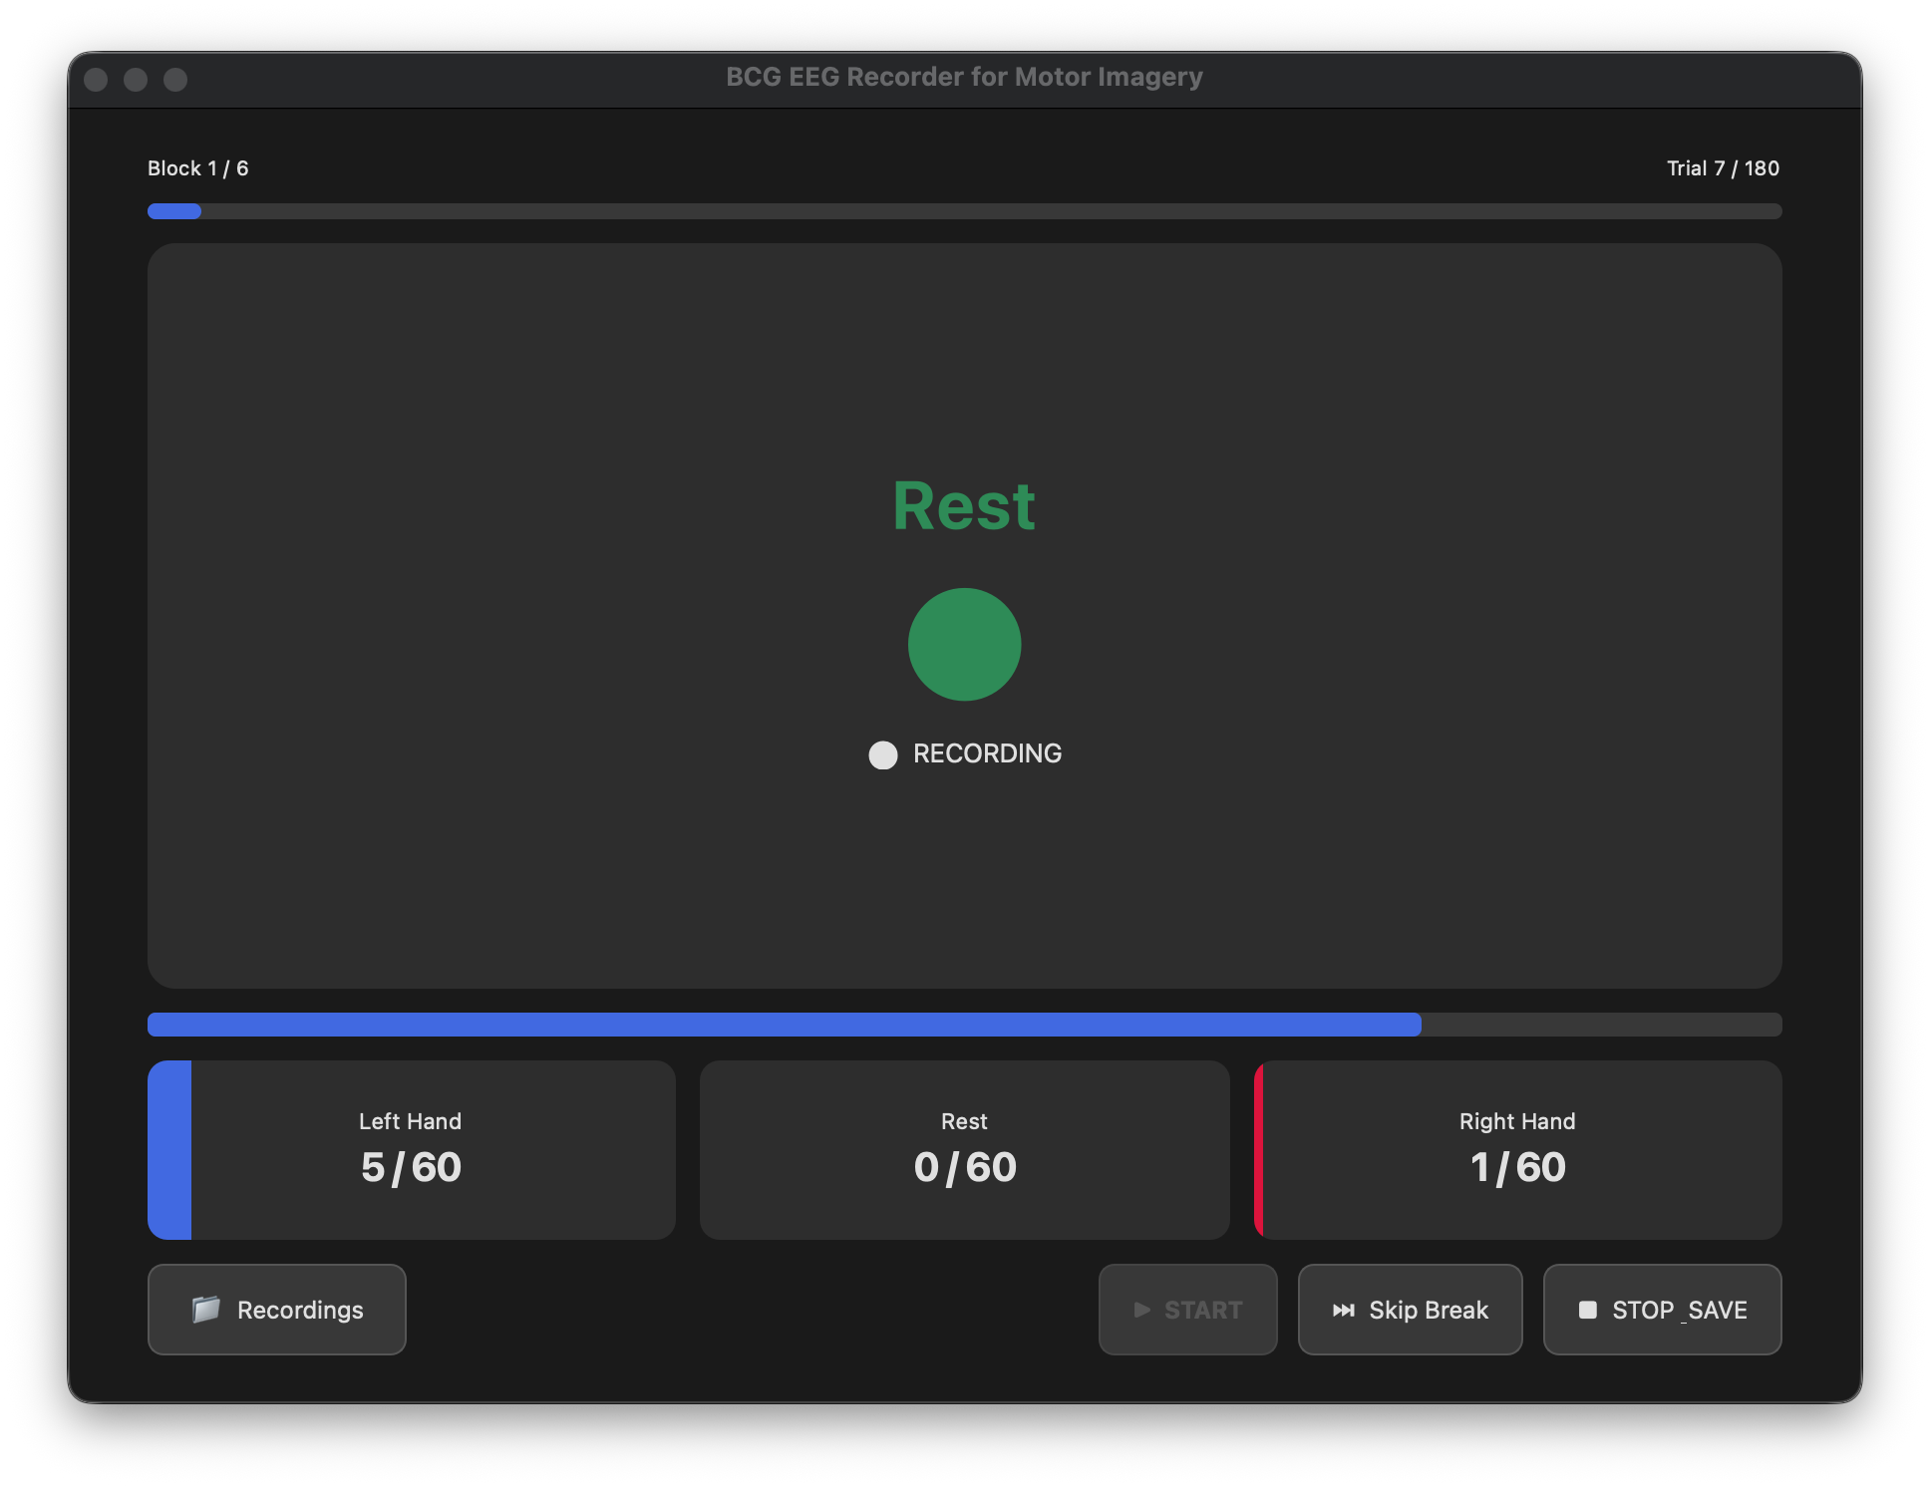
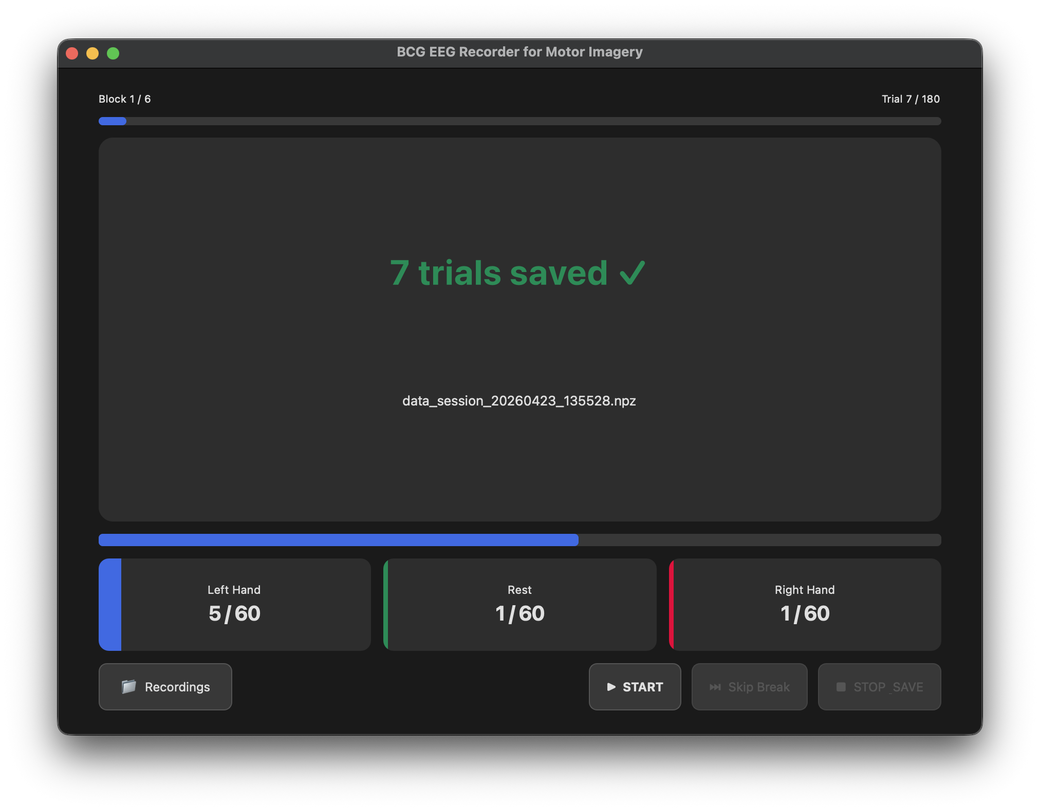
I. Finished tasks
2. Traditional Calibrating Method Design ^{[STP11]} - 100%

Slide 8
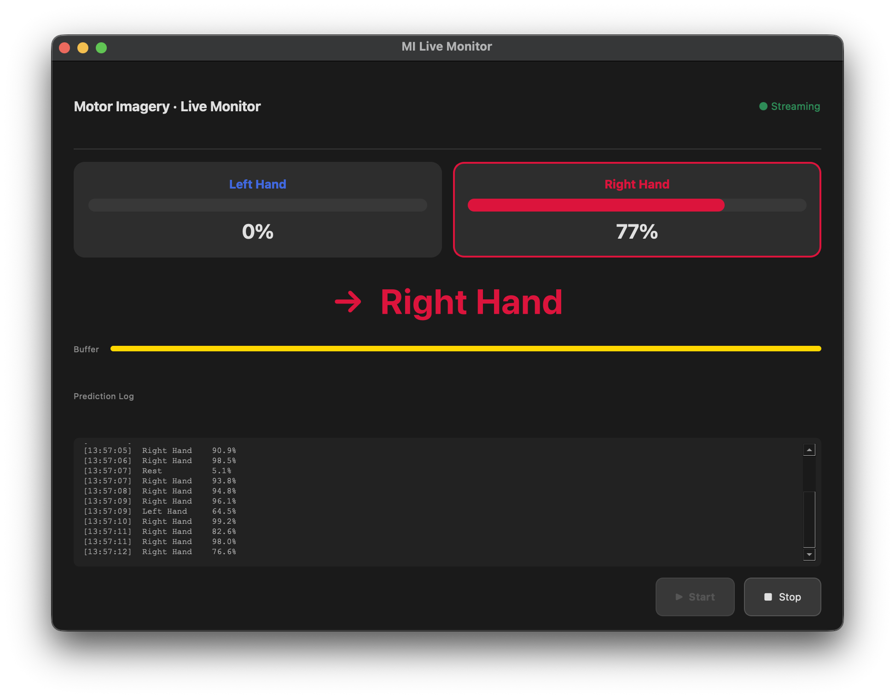
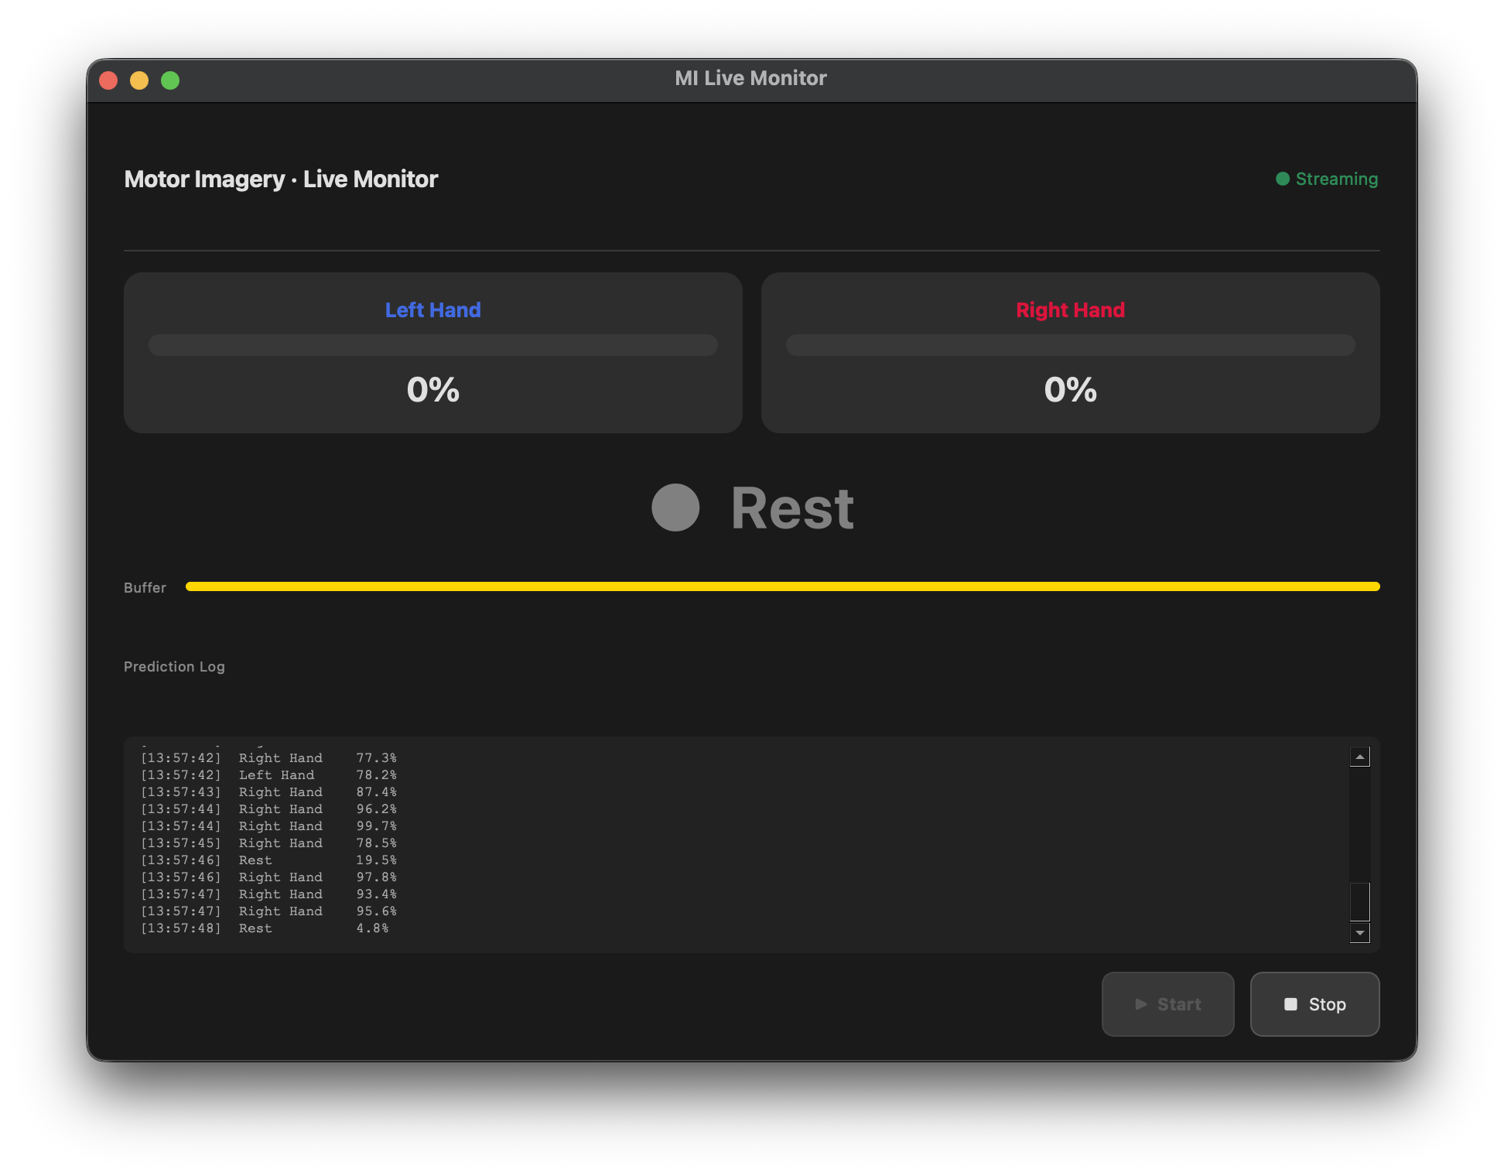
I. Finished tasks
2. Traditional Calibrating Method Design ^{[STP11]} - 100%

Slide 9
III. Current Difficulties
- The full-text deadline for BME conference
- Game idea

Slide 10
III. Next Plan
- Implement the game

Slide 11
THANK YOU
FOR READING!
Individual Honours Project
Dang Khoa Cao - Supervisor: PhD. Chi Thanh Vi
UIT ID: 23560023 | BCU ID: 25195675
23560023@gm.uit.edu.vn | dang.cao@mail.bcu.ac.uk

